Slide 1
Machine Learning Fundamentals
Daniel Bertills

Slide 2
Table of Contents
Exploration of the Dataset
Questions to Answer
Augmenting the Dataset
Regression Approaches
Classification Approaches
Conclusions / Next steps

Slide 3
Questions to Answer
I am looking to predict a members age by analyzing smoke, drugs and drink habits together with the members free text inputs (number of words and average length of words). I will be using regression models for this.
I will use two classification models to predict a members education level based on age group, total length of essays, average length of words and how often ‘education’, ‘college’ and ‘university’ is mentioned in the essays.

Slide 4
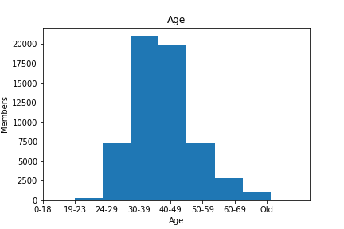
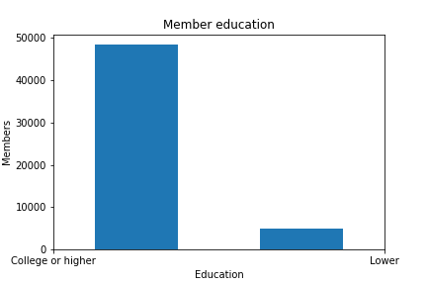
Exploration of the Dataset
I created age buckets and a binary education column. The education specification is a subjective selection from the member inputs under education.

Slide 5
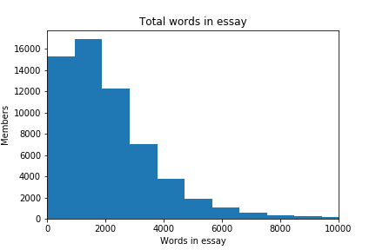
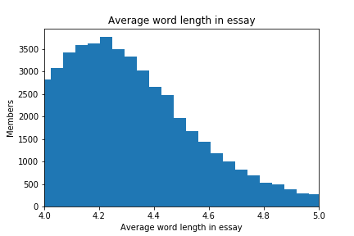
Augmenting the Dataset
I used split and count on the essays to be able to use it numerically. I also created functions to populate the dataset with them.

Slide 6
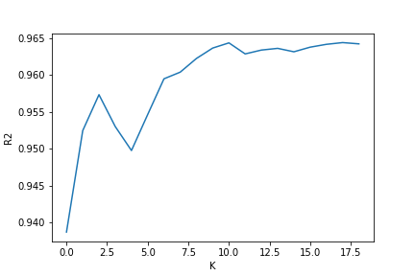
Regression Approaches
Multilinear Regression
Coef = [-0.09062489 -0.21352236 -0.09645559 0.05163477 0.00035529]
R2 = 0.04327166631288759
K-Nearest Neighbor Regressor
R2 = 0.964363422611513

Slide 7
Classification Approaches
K-Nearest Neighbor
F1 = 0.030658250676284943
Precision = 0.14166666666666666
Recall = 0.017189079878665317
Score = 0.8991935483870968
Support Vector Machines
F1 = 0.01593625498007968
Precision = 0.5333333333333333
Recall = 0.008088978766430738
Score = 0.9073518379594899

Slide 8
Conclusions / Next steps
Regression models
The multilinear model performed badly vs the K regressor. I appears that the more categorical inputs were a bad fit for multilinear regression. Performance wise there was no significant difference between running the models.
Classification models
Both models had about the same performance. Good score but very low F1, Precision, and Recall which indicates a lot of false positives and negatives. I believe this is due to the uneven class weights of the education_code column. I also used RobustScaler for the normalisation instead of MinMax to give less weight to outliers which maybe affected the distribution. The SVM required a lot more time to run as expected.

Slide 9
Further steps would be to continue to map the categorical columns numerically and try to find better features and labels. More work could also be done on text analyzing of the essays. Finding different ways to group words with other characteristics in the dataset.
Additional data on user activity on the app would have been a next step

